Slide 1

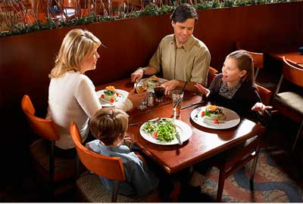
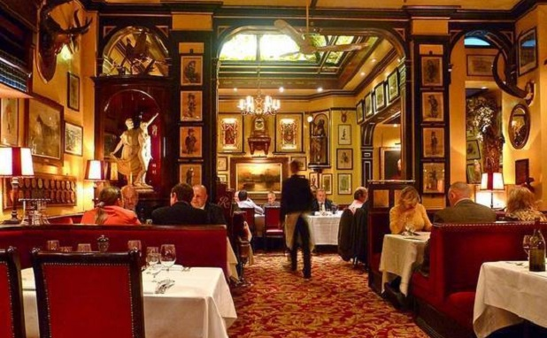
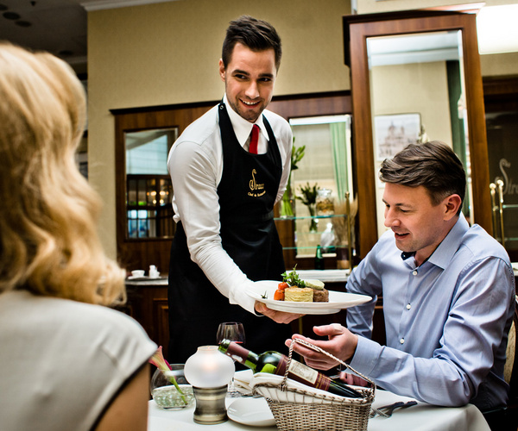
Visiting a restaurant.

Slide 2

Vocabulary
Hungry
A queue
A portion
To overcharge
To mix up
To be full
To turn out
To eat out

Slide 3
Phrases from the dialogues.
When we left, I was still hungry.
The price turned out to be reasonable.
The waiter mixed up our order.
I wouldn’t recommend it.
There was a really long queue.
First of all, there were so many dishes to choose from.
They overcharged us.
The portions were huge.
I was really full when we finished.

Slide 4
The right answers:
First dialogue
First of all, there were so many dishes to
choose from.
The portions were huge.
I was really full when we finished.
Second dialogue
When we left I was still hungry.
The prices turned out to be reasonable.
The waiter mixed up our order.
I wouldn’t recommend it.
There was a really long queue.
They tried to overcharge us.

Slide 5
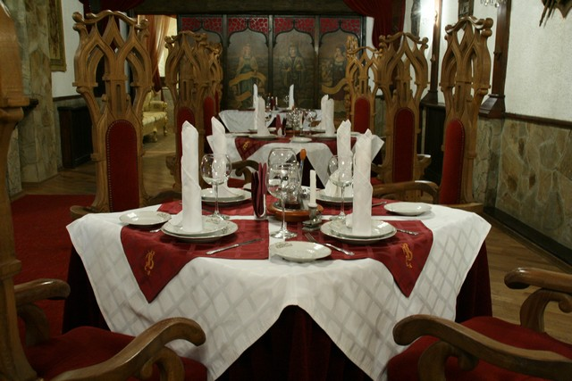
Thank you.

